Slide 1


Heart Disease Prediction System
Prepared By: Guided By:
Radadiya Hemish (201703100810012) Ms. Monali Gandhi
Bhadani Kanaiyalal(201703100810058) Assistant Professor , DIT
Vaghani Milan(201703100810063) CGPIT
B.Tech. IT (7th Semester)
CGPIT. .

Slide 2
Outline
Introduction
Motivation
Objective
Scope
Analysis for development
Modules
Diagrams
Technologies/Platform to be used for development
Implementation
Future work
References
12-12-2020
Heart Disease Prediction System, CGPIT

Slide 3
Introduction
The Prediction of Heart Diseases can save a lot of life and help doctors to design an effective treatment plan which ultimately reduces the mortality rate .
This project will focused on determining whether the patient has a heart disease or not by taking into consideration the UCI dataset.
12-12-2020
Heart Disease Prediction System, CGPIT

Slide 4
Motivation
A major challenge facing healthcare organization (hospitals,medical centers) is the provision of quality.
The main motivation of doing this research is to present a heart disease prediction model for the prediction of occurrence of heart disease.
12-12-2020-
Heart Disease Prediction System, CGPIT

Slide 5
Objective
The objective of this project is to devlope platform which provide the patient medical details and based on the features extracted the algorithm will then detect the heart disease.
This model is improve accuracy and also saves time and makes easier for doctors as well as patient to predict heart disease.
12-12-2020
Heart Disease Prediction System, CGPIT

Slide 6
Scope
The scope of the project is for a particular hospitals and medical centers.
Project can be modified to operate it online.
To find a specific disease patient.
12-12-2020
Heart Disease Prediction System, CGPIT

Slide 7

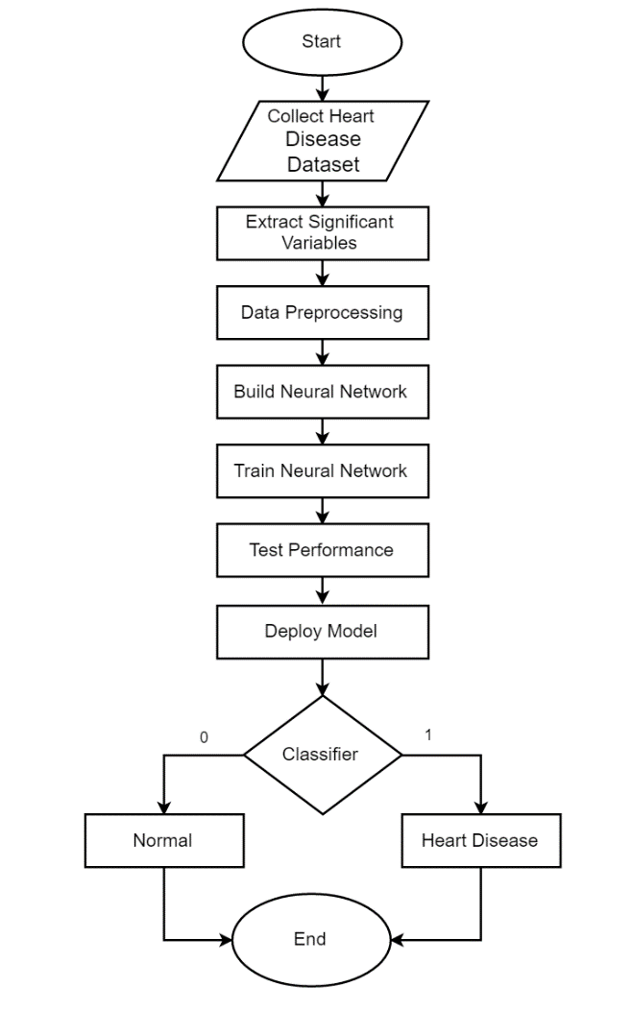
Analysis for development
12-12-2020
Figure 1. System Model
Heart Disease Prediction System, CGPIT

Slide 8
Modules
Gathering Patient’s data.
Processing Patient’s data.
Training patient’s data.
Analysis heart disease.
12-12-2020
Heart Disease Prediction System, CGPIT

Slide 9
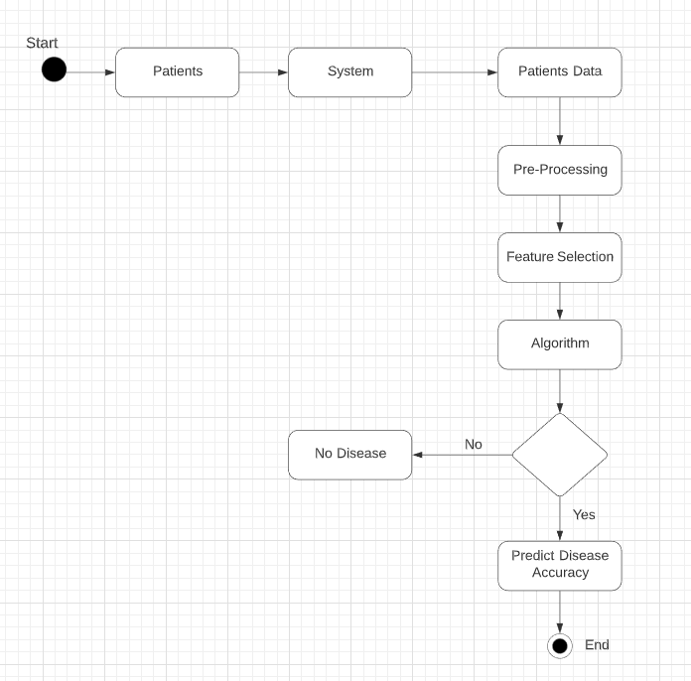
Diagrams
Activity diagram
Figure 2. Activity Diagram
12-12-2020
Heart Disease Prediction System, CGPIT

Slide 10
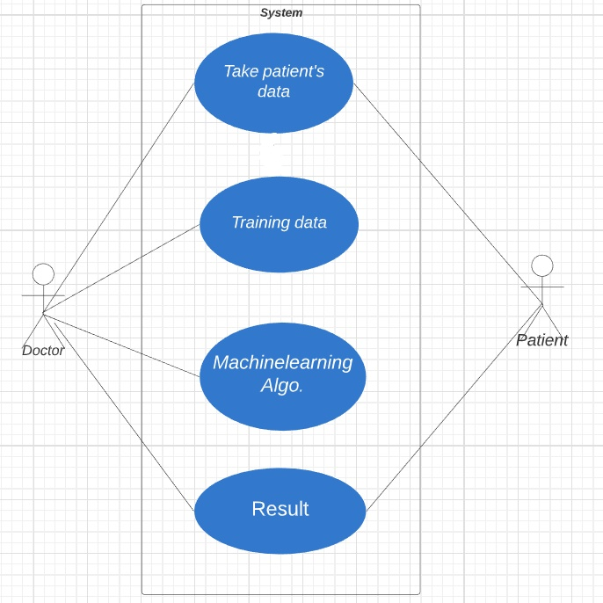
Usecase Diagram
Figure 3. Usecase Diagram
Heart Disease Prediction System, CGPIT
12-12-2020

Slide 11
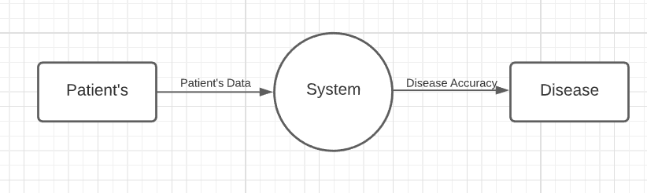
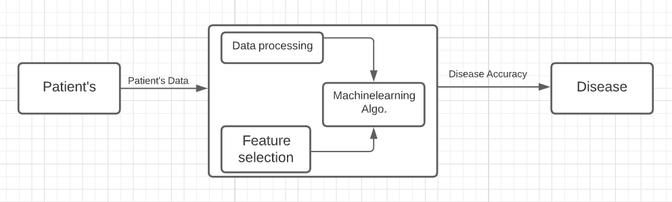
Data Flow Diagram
Figure 3. Level-0 DFD Diagram
Figure 4. Level-1 DFD Diagram
12-12-2020
Heart Disease Prediction System, CGPIT

Slide 12
Technologies
Front end : Python
Back end :Python[Colabnotebook,Jupyter]
Hardware : Windows
12-12-2020
Heart Disease Prediction System, CGPIT

Slide 13
Platform
Numpy Library
Pandas Library
Matplotlib Library
12-12-2020
Heart Disease Prediction System, CGPIT

Slide 14
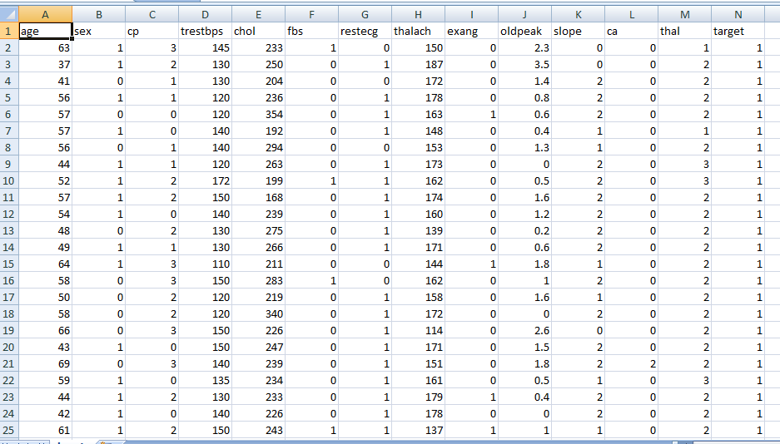
Database Schema
Table 1 : patient
12-12-2020
Heart Disease Prediction System, CGPIT

Slide 15
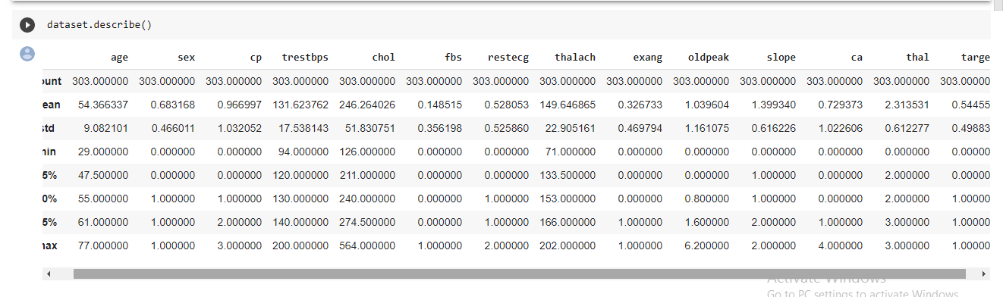
Implementation
Figure 5. Dataset Describe
12-12-2020
Heart Disease Prediction System, CGPIT

Slide 16
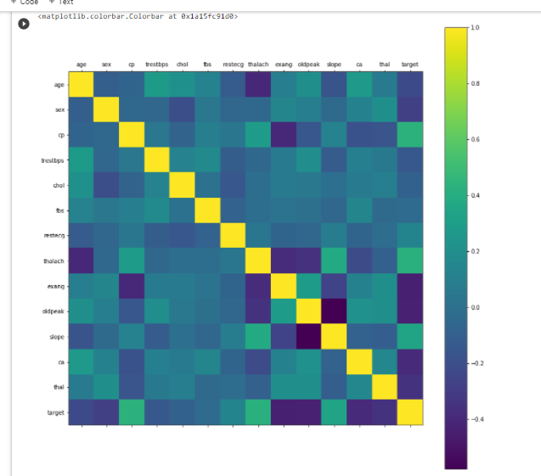
Implementation
Figure 6. Correlation Matrix Between Attributes
12-12-2020
Heart Disease Prediction System, CGPIT

Slide 17
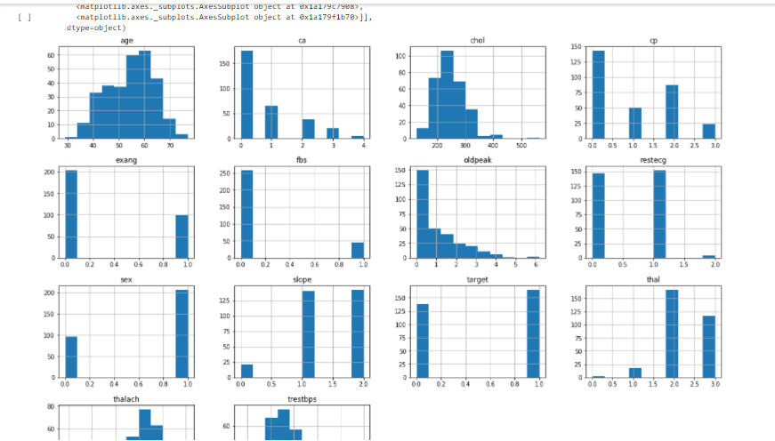
Implenff
Figure 7. Histogram of Each Attributes Has Different Rang of Distribution
12-12-2020
Heart Disease Prediction System, CGPIT

Slide 18
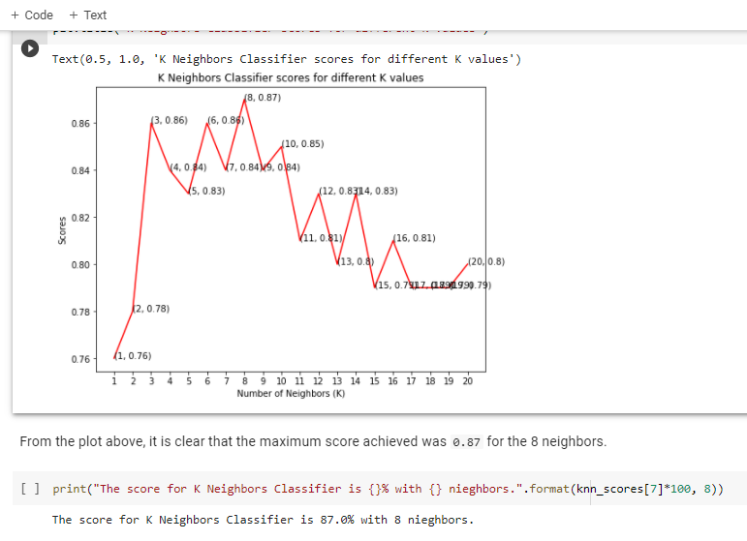
oiwoif
Figure 8. Accuracy Using KNN Algo..
12-12-2020
Heart Disease Prediction System, CGPIT

Slide 19
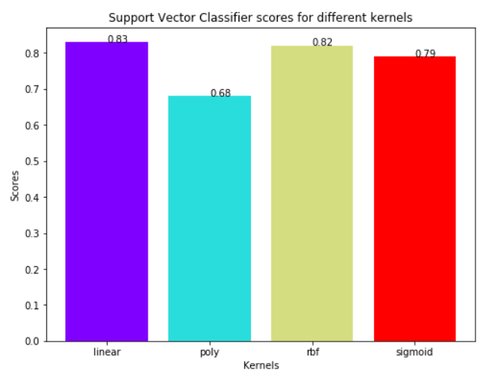
oiwoif
Figure 9. Accuracy Using Support Vector Classifer.
12-12-2020
Heart Disease Prediction System, CGPIT

Slide 20
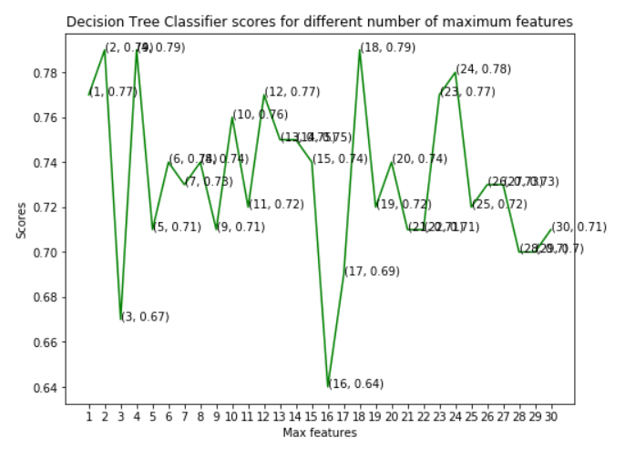
oiwoif
Figure 10. Accuracy Using Decision Tree Classifier.
12-12-2020
Heart Disease Prediction System, CGPIT

Slide 21
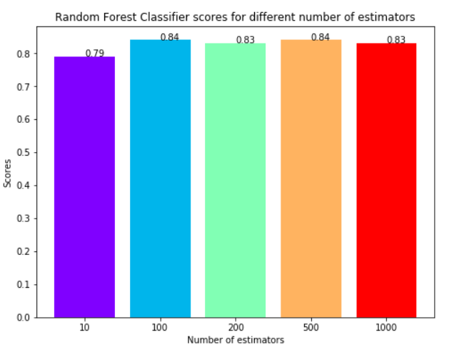
oiwoif
Figure 11. Accuracy Using Random Forest Classifier.
12-12-2020
Heart Disease Prediction System, CGPIT

Slide 22
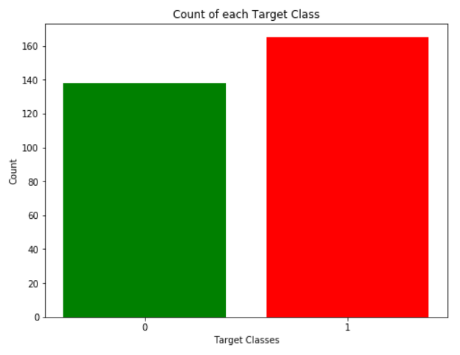
oiwoif
Figure 12. Count For Each Target Class.
12-12-2020
Heart Disease Prediction System, CGPIT

Slide 23
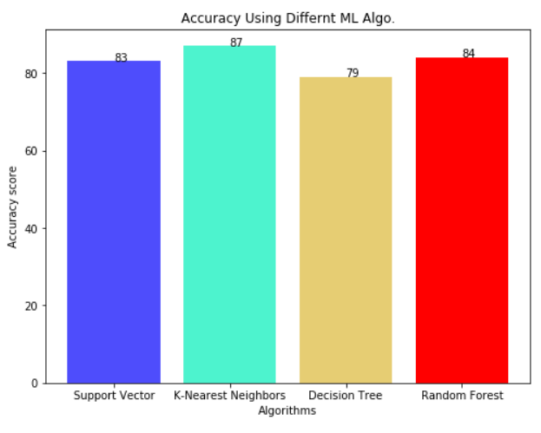
oiwoif
Figure 9. Accuracy Using Different ML Algo.
12-12-2020
Heart Disease Prediction System, CGPIT

Slide 24
Future work
This model will be useful in identifying the possible patient who may suffer form heart disease.
When a patient is predicted as positive for heart disease ,then the medical data for the patient can be closely analysed by the doctors.
12-12-2020
Heart Disease Prediction System, CGPIT

Slide 25
References [If applicable]
Web references
https://ieeexplore.ieee.org/document/8474922,Date accessed:[19/08/2020].
UCI, Heart Disease Data Set.[Online]. Available (Accessed on Aug. 22 2020): https://www.kaggle.com/ronitf/heart-disease-uci.
12-12-2020
Heart Disease Prediction System, CGPIT

Slide 26
Paper references
J. S. Rumsfeld, K. E. Joynt, and T. M. Maddox, “Big data analytics to improve cardiovascular care: promise and challenges”, Nature Reviews Cardiology, Vol.13, No.6, pp.350, 2016,Date accessed:[03/10/2020].
M. Lichman, “UCI Machine Learning Repositry”, [Online]. https://archive.ics.uci.edu/, 2013,Date accessed:[11/09/2020].
12-12-2020
Heart Disease Prediction System, CGPIT

Slide 27
Thank You!!
12-12-2020
Heart Disease Prediction System, CGPIT

